Slide 1
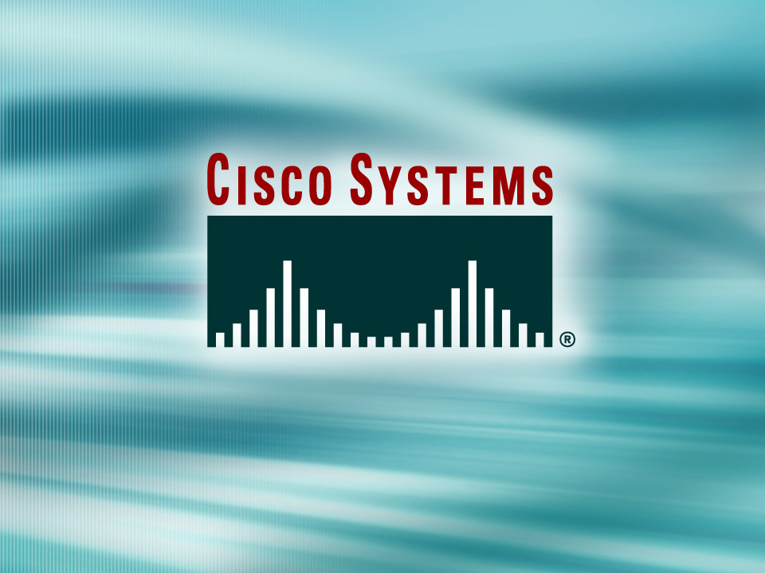
© 2002, Cisco Systems, Inc. All rights reserved.

Slide 2

Enabling IGRP
© 2002, Cisco Systems, Inc. All rights reserved.
Notes:
Purpose: This chapter introduces the Cisco IOS™ CLI on the Catalyst® 1900 switch and router.
Timing: This chapter should take about 2 hours to present.
Note: The Catalyst 1900 switch only has a subset of the router Cisco IOS commands available.
Contents:
Introduction to Cisco IOS. Explain to the student what is IOS?
Cisco Device startup procedures in general.
IOS configuration source.
General introduction to the IOS CLI.
Cat 1900 switch startup procedures.
Intro to Cat 1900 CLI. This part covers the basic configuration on the switch, like setting the IP address and hostname. More details about the various Cat 1900 switch configuration commands are explained in Chapter 6 and 7.
Router startup procedures. More details on the router startup process is discussed in chapter 5.
Router IOS CLI.

Slide 3
Objectives
Upon completing this lesson, you will be able to:
  Describe the features and operation of IGRP
  Use Cisco IOS commands to configure dynamic routing using IGRP, given a functioning router
  Use show and debug commands to identify anomalies in dynamic routing operation using IGRP, given an operational router
Notes:
Slide 1 of 2
Purpose: This slide states the chapter objectives.
Emphasize: Read or state each objective so that each student has a clear understanding of the chapter objectives.
Note: Catalyst switches have different CLIs. The Catalyst 2900xl and the Catalyst 1900 has a Cisco IOS CLI. The Cisco IOS CLI commands available on the 2900xl is different from the 1900. The Catalyst 5000 family has no Cisco IOS CLI, and use the set commands instead. This class only covers the configuration on the Catalyst 1900 switch.

Slide 4
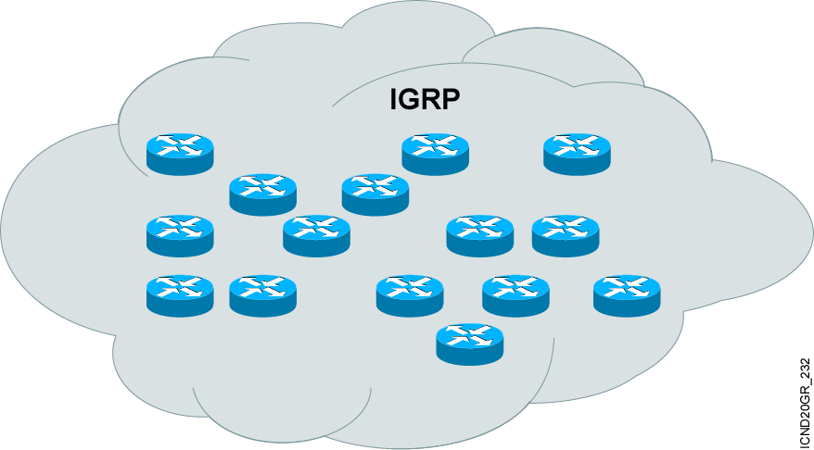
Introducing IGRP
  More scalable than RIP
  Sophisticated metric
  Multiple-path support
Notes:
Purpose: The figure introduces the IGRP routing protocol. IGRP is a sophisticated distance vector routing protocol.
Emphasize: The Interior Gateway Routing Protocol (IGRP) is a dynamic distance-vector routing protocol designed by Cisco in the mid-1980s for routing in an autonomous system that contains large, arbitrarily complex networks with diverse bandwidth and delay characteristics. Historically, IGRP became one of the success factors for the early Cisco IOS software capabilities because of its superiority to RIP version 1.
The important IGRP characteristics are as follows:
More scalability than RIP
Fast response to network changes
Sophisticated metric
Multiple-path support

Slide 5
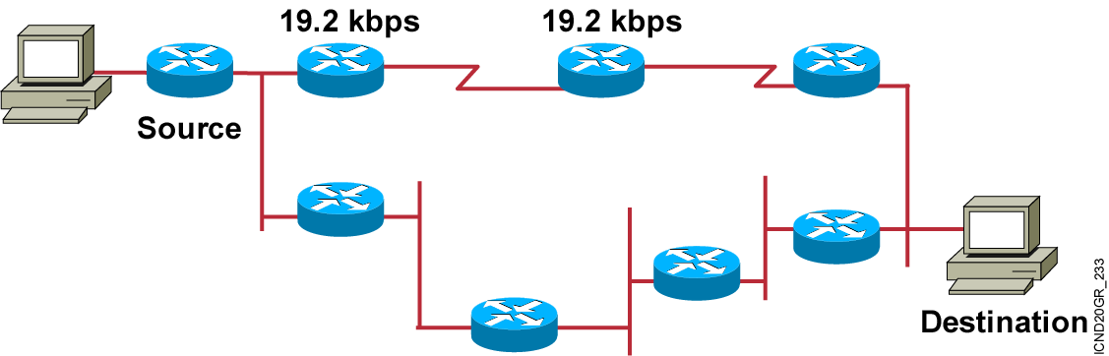
IGRP Composite Metric
  Bandwidth
  Delay
  Reliability
  Loading
  MTU
Notes:
Purpose: This figure presents the IGRP metric with its five possible components.
Emphasize : Bandwidth and delay are the two metrics that are most commonly used. They also comprise the default metric.
Note: Changing IGRP metrics can have great impact on network performance.
Describe the IGRP 24-bit metric field, as follows:
Bandwidth—Minimum bandwidth on the route, in kilobits per second.
Delay—Route delay, in tens of microseconds.
Reliability—Likelihood of successful packet transmission, expressed as an integer from 0 to 255.
Loading—Effective bandwidth of path.
MTU—Minimum MTU in path, expressed in bytes.
The following equation calculates the metric. It is presented for instructors and is not required to be taught:
metric = [k1 x bandwidth + (k2 x bandwidth) / (256 - load) + k3 x delay]
If k5 does not equal 0, an additional operation is done:
metric = metric x (k5/(reliability + k4))
The default constant values are k1 = k3 = 1 and k2 = k4 = k5 = 0.
Again, if default values are set, metric = bandwidth + delay.
The constants (k1, k2, k3) can be changed using the metric weights command. Changes to the IGRP constant values should be made with great care.

Slide 6
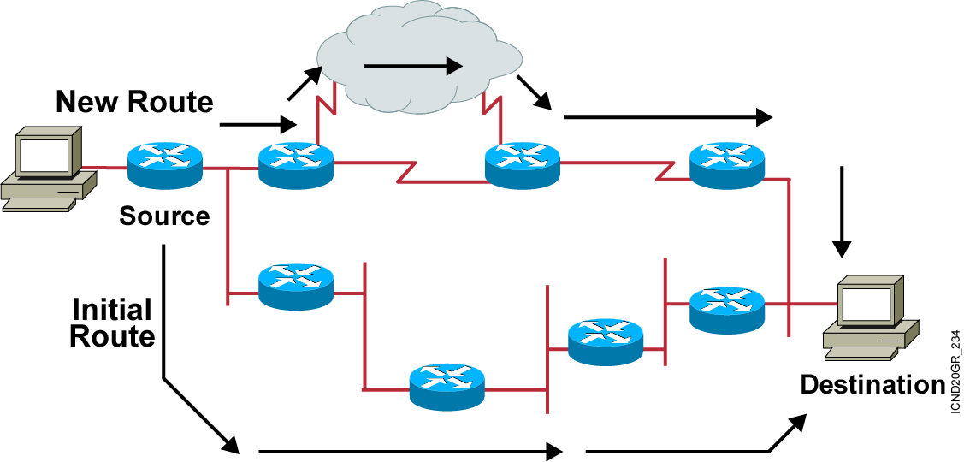
IGRP Unequal Multiple Paths
  Maximum 6 paths (default = 4)
  Within metric variance
  Next-hop router closer to destination
Notes:
Purpose: The figure presents how IGRP load sharing improves throughput and increases reliability.
Emphasize: Only feasible paths can be used for IGRP load sharing.
Load-balancing methods vary according to the switching mode because the data structures for process switching, fast switching, and autonomous switching are all different. When process switching, the processor load-balances packet by packet. When fast, autonomous, or silicon switching, load balancing is done destination by destination.
By default, the amount of variance is set to one, which results in equal-cost load balancing.
You can use the default-metric command to change the default metric.
Transition: The following pages describe how to configure the IGRP routing protocol.

Slide 7
Configuring IGRP
Router(config)#router igrp autonomous-system
Defines IGRP as the IP routing protocol
Router(config-router)#network network-number
Selects participating attached networks
Notes:
Slide 1 of 2
Purpose: This figure explains how to use the router igrp and network commands to configure an IGRP process.
Emphasize: Note that the AS keyword is required for IGRP.
You can use multiple network commands to specify all networks that are to participate in the IGRP process. Only those networks specified will be published to other routers.

Slide 8
Configuring IGRP (cont.)
Router(config-router)#variance multiplier
Controls IGRP load balancing
Router(config-router)#traffic-share {balanced | min}
Controls how load-balanced traffic is distributed
Notes:
Slide 2 of 2
Purpose: This figure displays the commands to allow load sharing and load balancing in an IGRP environment.
Emphasize: Note the router configuration mode to the students.

Slide 9
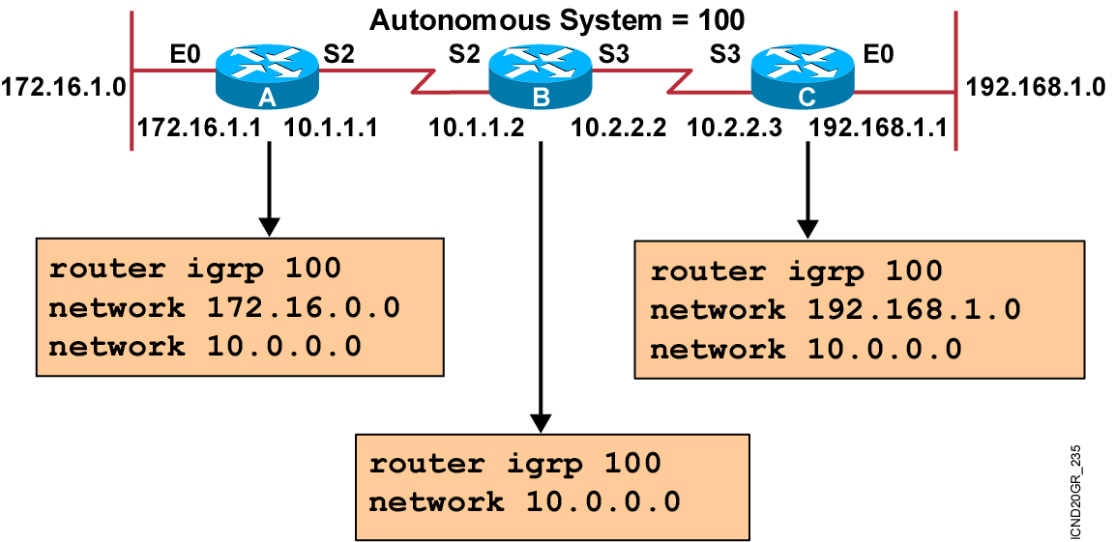
IGRP Configuration Example
Notes:
Purpose: The figure shows how the IGRP commands operate on the example network.
Emphasize: An administrator only specifies directly connected networks that should be published to other routers.
Without the network command, nothing is advertised. With a network command, the router will advertise every subnet within the Class A, B, or C network specified in the configuration.

Slide 10
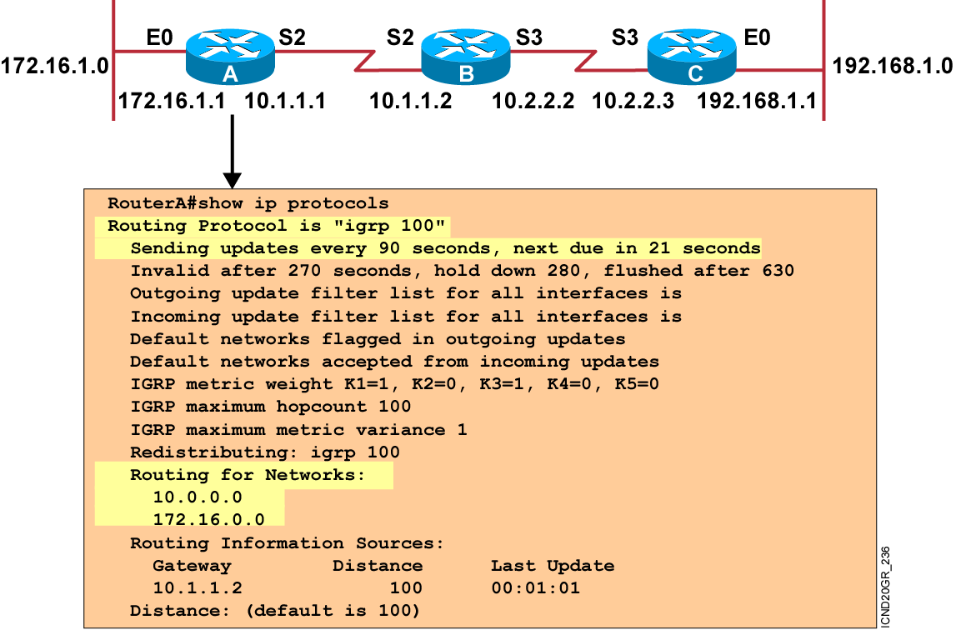
Verifying the IGRP Configuration
Notes:
Purpose: This figure shows how the show ip protocol command is used to monitor IGRP operation.
Emphasize: The command displays the routing protocols that are active on the router for IP. It also gives network and timer information. In this example, IGRP is displayed.
Point out the timing information.
Point out the list of networks for which the router is injecting routes.
Point out the administrative distance metric.

Slide 11
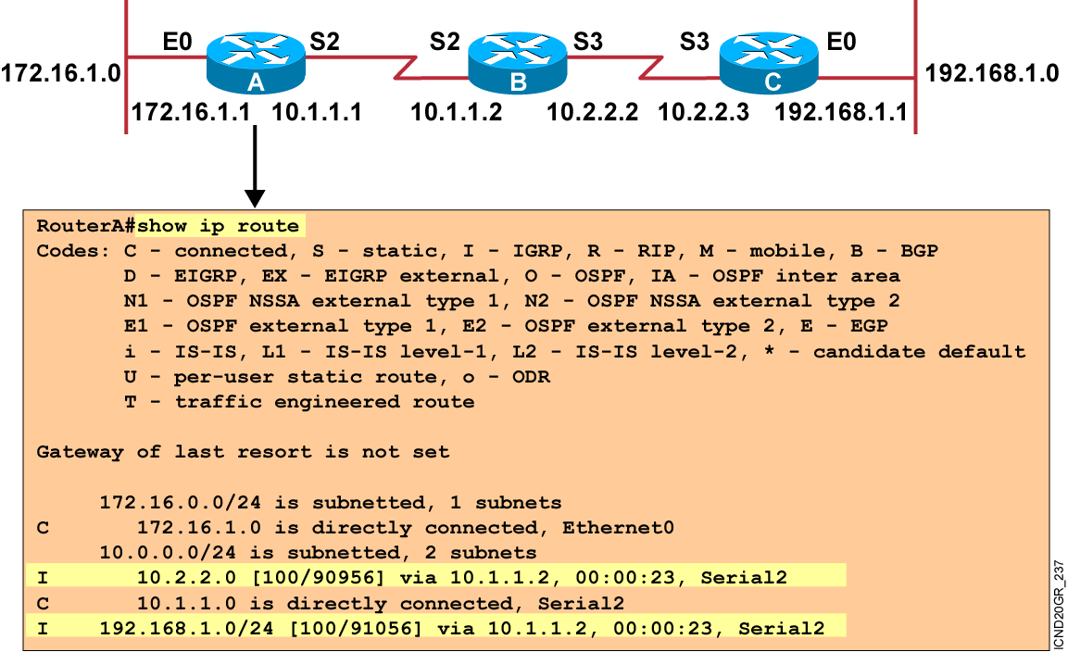
Displaying the IP Routing Table
Notes:
Purpose: This figure displays the show ip route command, which displays the contents of the router’s IP routing table.
Emphasize: This is the same command presented earlier in the chapter. Discuss the IP routing table in detail. The [100/90956] represent the administrative distance and metric, respectively.
Discuss the following fields:
I—Refers to routes learned from IGRP.
via—Refers to the router that informed us about this route.
00:00:23 timer value—IGRP updates are every 90 seconds. Ask, “How long until the next update?”
The interfaces used for the best path.

Slide 12
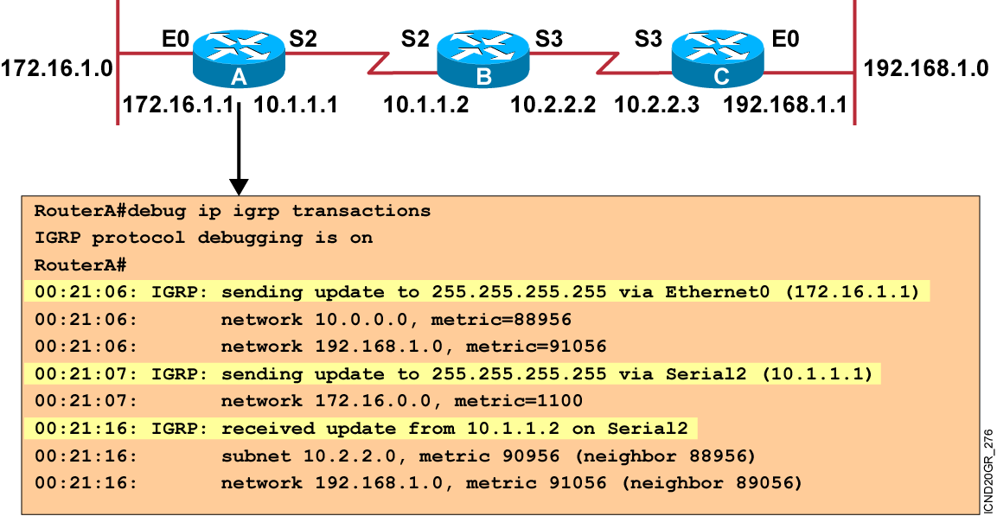
debug ip igrp transaction Command
Notes:
Purpose: This figure presents the debug ip igrp transaction command.
Emphasize: The debug ip igrp transaction command displays all updates that are sent from and received by your router.

Slide 13
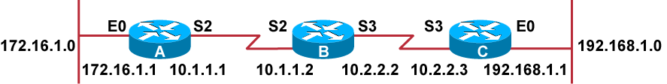
debug ip igrp events Command
RouterA#debug ip igrp events
IGRP event debugging is on
RouterA#
00:23:44: IGRP: sending update to 255.255.255.255 via Ethernet0 (172.16.1.1)
00:23:44: IGRP: Update contains 0 interior, 2 system, and 0 exterior routes.
00:23:44: IGRP: Total routes in update: 2
00:23:44: IGRP: sending update to 255.255.255.255 via Serial2 (10.1.1.1)
00:23:45: IGRP: Update contains 0 interior, 1 system, and 0 exterior routes.
00:23:45: IGRP: Total routes in update: 1
00:23:48: IGRP: received update from 10.1.1.2 on Serial2
00:23:48: IGRP: Update contains 1 interior, 1 system, and 0 exterior routes.
00:23:48: IGRP: Total routes in update: 2
Notes:
Purpose: This figure presents the debug ip igrp events command.
Emphasize: When there are many networks in your routing table, displaying every update for every route can flood the console and make the router unusable.
The debug ip igrp events command displays a summary of IGRP routing messages. This command indicates the source and destination of each update, as well as the number of routes in each update. Messages are not generated for each route.

Slide 14
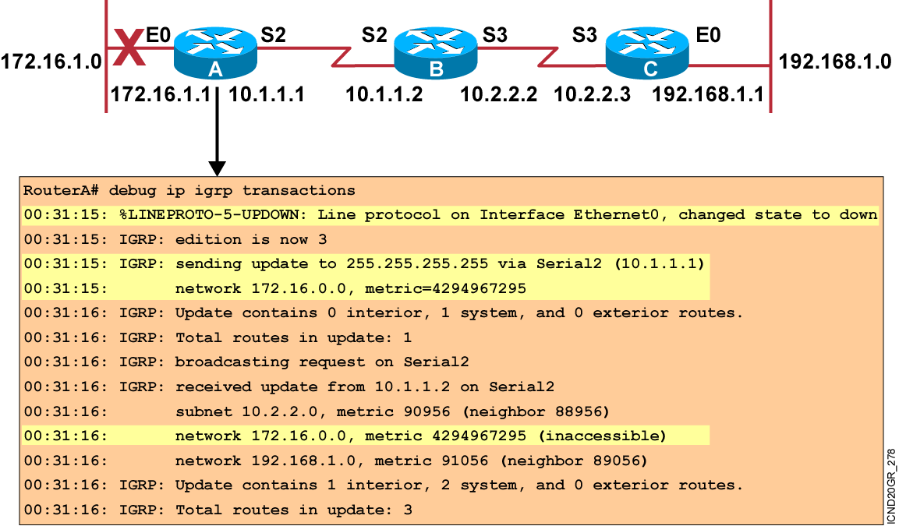
Updating Routing Information Example
Notes:
Slide 1 of 4
Purpose: The next few pages illustrate IGRP update operation when network information changes.
Emphasize: Network 172.16.0.0 fails. Router A sends a triggered update to router B.

Slide 15
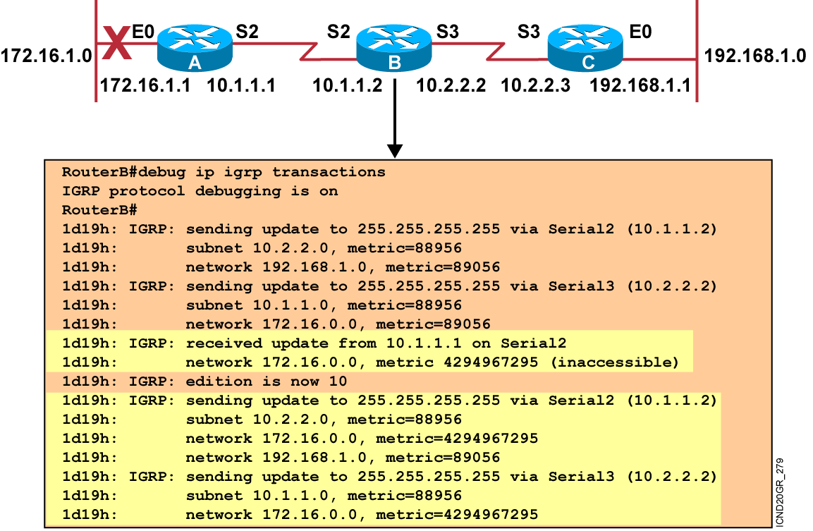
Updating Routing Information Example (Cont.)
Notes:
Slide 2 of 4
Purpose: This figure continues to illustrate IGRP update operation when network information changes.
Emphasize: Router B receives the triggered update from router A, sends a poison reverse to router A, and sends a triggered update to router C.

Slide 16
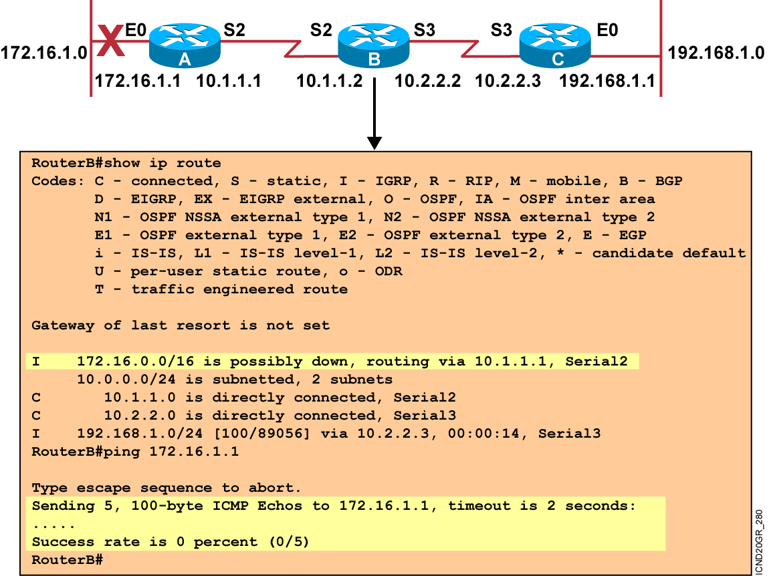
Updating Routing Information Example (Cont.)
Notes:
Slide 3 of 4
Purpose: This figure continues to illustrate IGRP update operation when network information changes.
Emphasize: Router B places route to network 172.16.0.0 in hold-down state. The route is marked as “possibly down” while in holddown. Router B will still attempt to forward packets destined to 172.16.0.0.

Slide 17
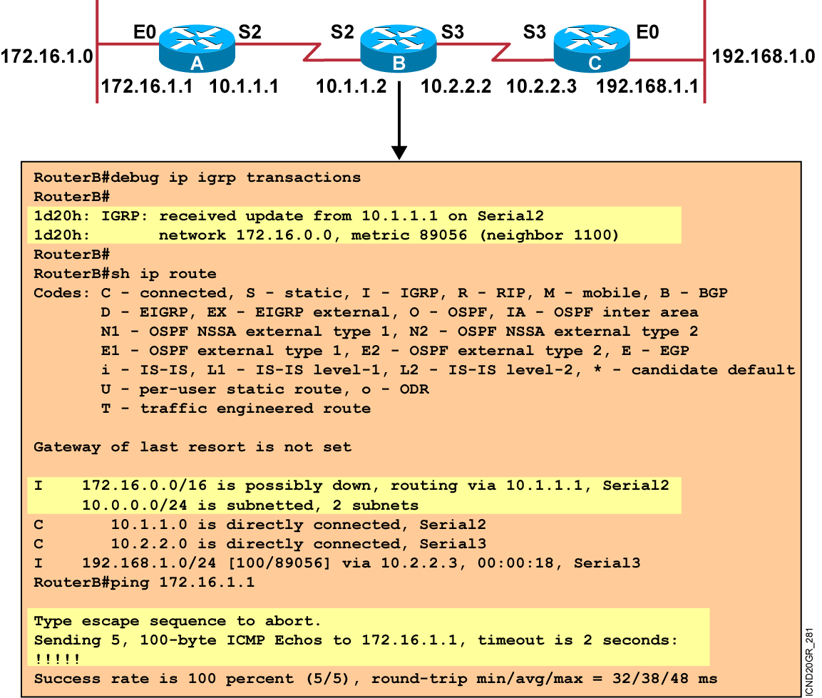
Updating Routing Information Example (Cont.)
Notes:
Slide 4 of 4
Purpose: This figure continues to illustrate IGRP update operation when network information changes.
Emphasize: If the link comes back up, router A will send another triggered update to router B. Router B will not update its routing table until the hold-down timer expires.

Slide 18
Summary
  IGRP has several key features such as increased scalability, a sophisticated metric, and multiple paths.
  IGRP uses a composite routing metric that can include bandwidth, delay, reliability, loading, and MTU value.
  The IGRP composite routing metric supports multiple paths between source and destination.
  Use the router igrp and network commands to create an IGRP routing process. Use the variance and traffic-share commands to configure IGRP load balancing.
  Use the show ip protocols and show ip route commands to display information about your IGRP configuration.
  Use the debug ip igrp transaction command to display transaction information on IGRP routing transactions and the debug ip igrp events command to display a summary of the IGRP routing information.
Notes:
Purpose: This slide discuss the initial configurations on the routers and switches.
Note: There is no setup mode on the Catalyst 1900 switch.

Slide 19


